Slide 2
Ohio bwc library services
Capital Area Safety Council
Andrew Hart, MSLS, MSS, OHST, ASP
Research Librarian

Slide 3

Ohio bwc library Services
Learn how BWC’s librarians can help your business succeed in safety!
Ohio BWC Library
30 W. Spring Street, Fl. 3, Columbus, OH 43215
library@bwc.ohio.gov
614-466-7388
Notes:
Picture taken by Andrew Hart
The physical library space is open Monday through Thursday 8:30 am to 4:30 pm. On Fridays, the library is closed, but library staff is still available via phone and email.

Slide 4
Ohio BWc library staff
Sharon Roney, MSLIS – Library Administrator
Amie Klein, MSLIS – Collections Development Librarian (Librarian II)
Andrew Hart, MSLS, MSS, OHST, ASP – Research Librarian (Librarian II)
Molly Arnold – Library School Graduate Intern
Notes:
All BWC library staff possess a master’s degree in library science and have over four decades of combined experience.
We have combined experienced in:
Government libraries
Special collections
Public libraries
Prison libraries
Academic libraries
Ohio EPA
The library also employs a college intern that works on an ever-expanding list of archival and museum projects.

Slide 5

Library service offerings
Research
Safety standards
Literature searches
Streamery (online safety videos)
Written safety plan/policy templates
Handouts, quizzes, PowerPoints
Books
Archive/Museum
NSC benchmarking (time permitting)
Notes:
Picture from PPT’s image search feature

Slide 6
Research
Questions related to occupational safety and industrial hygiene can be emailed to the library: library@bwc.ohio.gov, submitted online, or called in: 614-466-7388.
We will respond through our answering software, Reftracker, which will email you our answer and any attachments.
Demo
Notes:
DEMONSTRATE online form
No question is too basic or too technical for us to research.
We use the Ohio Fire Code, NFPA, NEC, OSHA, Ohio Building Code, ANSI standards, NIOSH, Ohio Administrative Code, Ohio Revised Code, case laws, other Code of Federal Regulation (CFR) statutes, and much more to find answers to safety and industrial hygiene questions.
Do not feel that your question is not worthy of our time. It’s always better to doublecheck if you doubt something.

Slide 7
Research question examples
What are the NFPA lighting requirements for egress routes?
What are the color requirements for safety vests?
What are the labeling requirements for electrical panels?
What are the height requirements for welding curtains?
What are the requirements for Exit signs in buildings?
What is needed in first-aid kits?
What is the distance requirement for eyewash stations/emergency showers?
What are the safety requirements for industrial steel storage racks?
How do I properly store compressed gas cylinders?
Notes:
These are examples of basic questions that we’ve received, but we also get asked more technical questions. For instance, this past year, an employer was referred to us by one of our consultants to search for safer solvent alternatives to using Methyl Ethyl Ketone.
For statistics, we can provide you with BLS-provided data on a wide variety of different searches. We can search by year, state, occupation, source of injury/illness, event, and much more.
We can also provide you with BWC claim cost information.
Refer to consultation services.

Slide 8
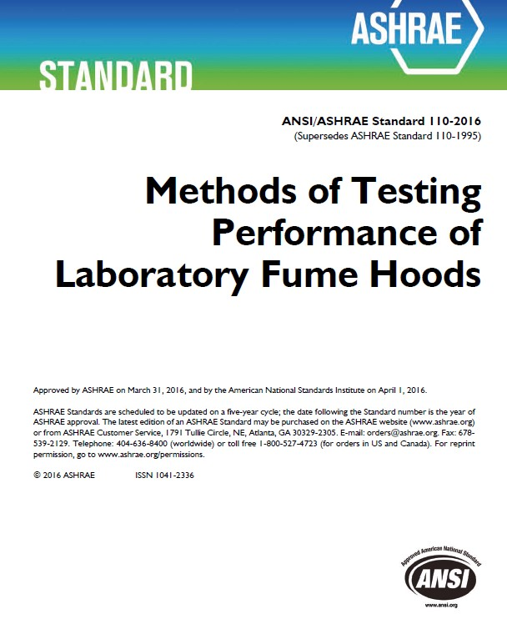
Safety standards
We currently have a combined 1,107 safety standards in our paper and digital collections
We have multiple consensus groups represented in our collection, including CGA, ASTM, ASHRAE, ALI, ASSE, ASME, ASSP, ISO, CSA, AWS, and IWCA.
Notes:
Standards do not circulate publicly
Ask us for a standard’s table of contents
We can find what you’re seeking, copy it, and then email it

Slide 9
Safety standard examples
Z87.1 – Eye and Face Protection
Z358.1 - Emergency Eyewash and Shower Equipment
Z308.1 – Minimum Requirements for First Aid Kits
B11.19 - Performance Requirements for Risk Reduction Measures: Safeguarding and other Means of Reducing Risk
CGA P-1 - Safe Handling of Compressed Gases in Containers
ISEA 121 – American National Standard for Dropped Object Prevention Solutions
MH 29.1 – Industrial Scissor Lifts
Notes:
A list of available standards is available upon request. Please email us.

Slide 10
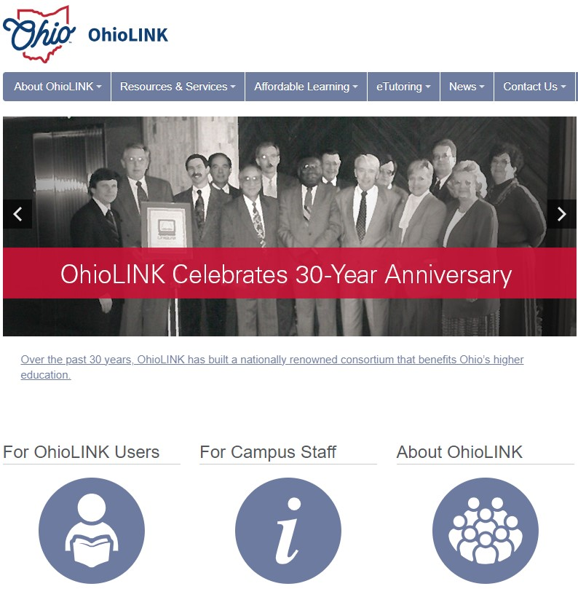
Literature searches
Journal articles
White papers
Reports
Book chapters
Notes:
If you would like recent research updates about a particular topic, just let us know!
Example: “Recently published research on exoskeletons in the last three years.”
Specify year range. Usually, we search the last five years unless specified.

Slide 11
Literature searches – best practices
Beneficial when there is an industry-specific question about best practices
For example, when asked about bakery/bread delivery driving safety, and issues related to ergonomics of loading/unloading trucks at bakeries/stores, we might search the following organizations to see if they have best practices in the form of guides/reports/white papers:
  American Bakers Association
  Bakery Equipment Manufacturers and Allieds (BEMA)
  The Bread Bakers Guild of America
  International Foodservice Distributors Association
  International Dairy Deli Bakery Association
  National Grocers Association
  Retail Bakers of America
Notes:
This option is helpful for niche topics or issues, like PPE in the landscaping industry.
We might automatically revert to this type of search if there are no resources found through OSHA, safety standards, or NIOSH.

Slide 12

Streamery (online safety videos)
Free
Online 24/7 access
New videos added all the time
Videos cover a wide range of topics, including:
  Crane safety
  Fall protection
  OSHA Recordkeeping
  PPE (eye, head, hand, hearing, etc.)
  Bloodborne pathogens
Demo
Notes:
DEMONSTRATION of accessing and using Streamery.
ALSO DEMONSTRATE the list of streaming topics on the FAQ page.
DVD videos are being sunsetted 06/30/2025
Current procedure of registering as a borrower (if they haven’t already) and then emailing the library for access
Future procedure of using an online form, which will send us a request. We’ll then email you with your log-in info.

Slide 13
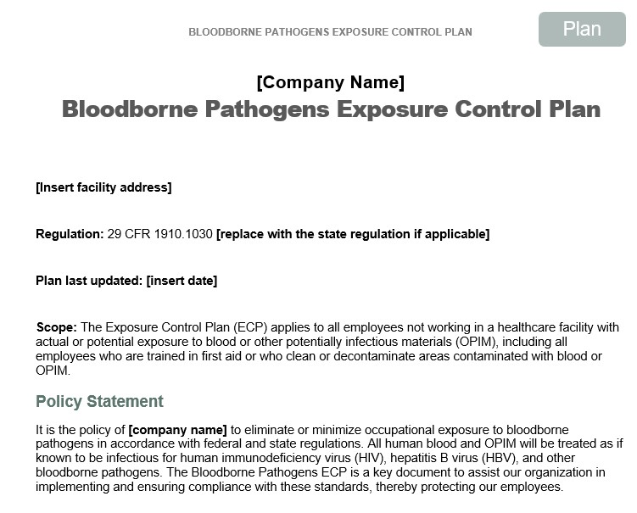
Written safety plan/policy templates
Safety BLR
Templates are fully customizable Word documents
In addition to templates, we can provide examples of active, in-use plans/policies, just ask!
Notes:
The library has a consultancy license that permits us to provide Safety BLR materials to our library patrons.
We can provide examples of in-use plans/policies from universities and companies that place them online.
We encourage you to work with your local safety consultant if you need assistance updating your current written plan or policy and for when writing one from scratch.

Slide 14
Handouts, Quizzes, PowerPoints
Safety BLR
We can provide the following for almost any safety topic:
  Safety BLR 7-Min Safety Trainer (Outline, Handout, Quiz)
  Checklists
  Handouts
  Posters
  PowerPoints
Notes:
PowerPoints almost always are fully notated with speaker notes.
7-Min Safety Trainers are exceedingly helpful, and provide a speaker outline, handout, and a quiz.
I have provided you with a sample 7-Min Safety Trainer for you to take back to the office.

Slide 15
Books
Introduction to safety
Industrial hygiene
Toxicology
Ergonomics
Accident investigation
Leadership
Business/Project management
Ventilation/fire safety/hearing conservation/electrical safety
Demo
Notes:
DEMONSTRATION. Show how to access book catalog.
If you’re interested in getting a book from our collection, please contact the library. If you don’t have a State Library of Ohio library card, we can make you one and mail it with your book loan.
Our library collection is one of the few in the nation that specializes in issues related to workplace safety and health.
If you’re new to safety, would like a book to refresh some safety skills, or are interested in continuing education, please let us know what you’re looking for and we can find something in our collection for you.

Slide 16
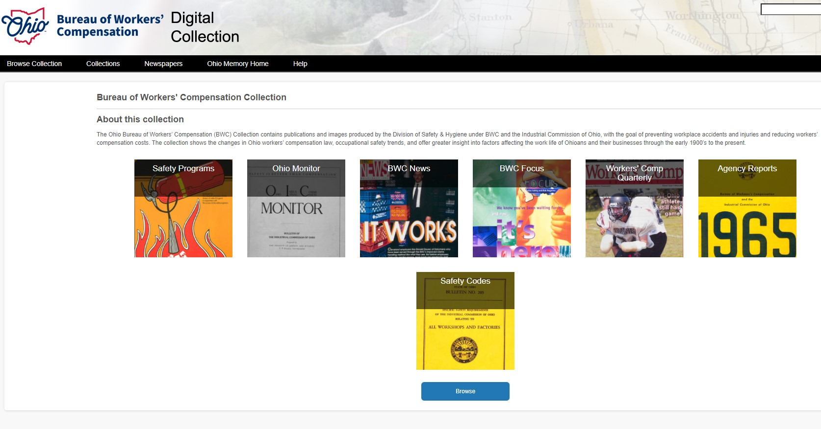
Archive/Museum
The library hosts a collection of important documents and publications from the beginning of BWC’s history to the present.
Digitized documents can be found on Ohio Memory.
Demo
Notes:
DEMONSTRATE how to access via the Historical Archives page.
Safety Programs is a collection of safety posters and stickers that were created from 1920’s to the early 2000’s to help educate workers about dangers in the workplace.
The Ohio Monitor spans the history of the Ohio Industrial Commission and BWC from 1928 to 1997.
Safety Codes collection contains historical Specific Safety Requirements from 1924 to the early 2000’s.

Slide 17
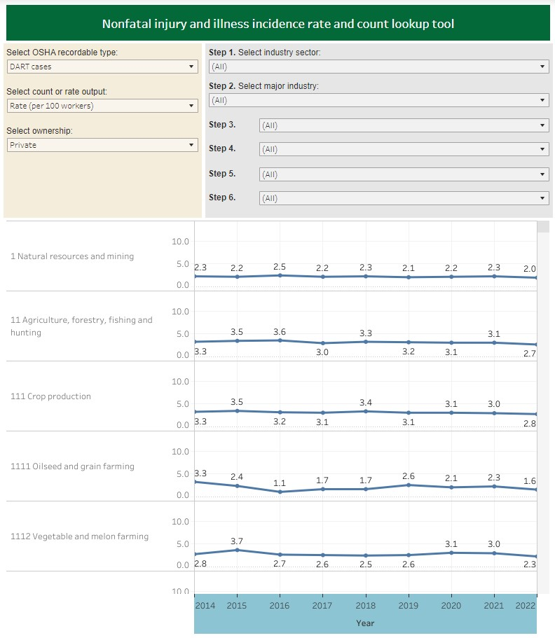
National safety council – how to benchmark
Benchmarking is a tool that’s used to see where your company performs safety-wise with those in the same industry.
If you know your NAICS and injury information, you can use NSC’s calculator and incidence rate chart to compare your company’s rates with others.
Demo
Notes:
DEMONSTRATE how to use the calculator and how to use the chart.
The “Steps” indicate the NAICS level at which you’re searching. The more “Steps” the more exact results will be.

Slide 19

BWC Safety services
Consultation Services Include:
Facility/operational assessments
Safety management assessments
Project facilitation
On-site training
Safety team development/improvement
Program/process development
Return-to-work consultations
Air sampling
Noise sampling
Physical hazard assessments
Notes:
The QR code will take you to page where you can request safety consultations.
Industrial Hygiene
Safety
PERRP:
Specifically for government (county, state) employers
Compliance assistance services include:
Risk reduction inspections
Industrial hygiene sampling
Written program/policy reviews
Training
OSHA On-Site:
This program is for small- to medium-sized, high-hazard private employers
If you’re unsure how OSHA regulations apply to your workplace, need help identifying hazards, or want to improve your safety systems, this program is for you.

