Slide 2

november 2024 Safety Council Update
Capital Area Safety Council
David
Vandergrift
bwc.ohio.gov
Safety Consultant
Office of Safety & Hygiene, Region 5
614-359-3554
David.V.1@bwc.ohio.gov
Notes:
*REQUIRED SLIDE*
QR Code takes you to BWC website.

Slide 3



Monthly Learning November 2024
Nov 5 – First aid in the workplace
  Cincinnati/Springdale
Nov 7 – Respirators: Do we need them?
  Cincinnati/Springdale
Nov 12 – First aid in the workplace
  Canton
Nov 13 – Tree work essentials: Chainsaws, chippers, and other safety concerns
  Knox County - Mt Vernon
Nov 14 – Hazardous waste operations and emergency response refresher
  Columbus – Ohio Fire Academy
Nov 19 – First aid in the workplace
  Cleveland/Independence Indiana Wesleyan University
Nov 19-20 - OSHA 10: Construction safety basics
  Toledo/Bowling Green State University
bwclearningcenter.com
IN-PERSON CLASSES and VIRTUAL TRAINING CLASSES (VTC) qualify for Safety Council rebate external training credits.
Notes:
Info found on BWC Learning Center is the most accurate. QR Code takes you to BWC Learning Center. Use log on credentials to see the training schedule.

Slide 4
Monthly Learning December 2024
Dec 3-4 - OSHA10: Industry safety basics
  Mid-Ohio Conference Center
Dec 4 - First aid in the workplace
  Wolf Event Center 201
Dec 4-5 - OSHA10: Construction safety basics
  Cincinnati/Springdale
Dec 5 - Electrical safety in the workplace through insight and implementation of NFPA 70E
  Indiana Wesleyan University
Dec 5 - OSHA 10: Construction industry outreach training Spanish
  Allied Construction Industries, Cincinnati
Dec 10-11 - OSHA 10: Industry safety basics
  Edison State Community College
Dec 12 - OSHA 10: Construction industry outreach training Spanish
Allied Construction Industries, Cincinnati
bwclearningcenter.com
IN-PERSON CLASSES and VIRTUAL TRAINING CLASSES (VTC) qualify for Safety Council rebate external training credits.

Slide 5
virtual training November/December 2024
Nov 5 - Job safety analysis
Nov 6 - Safety for the non-safety professional workshop
Nov 13-14 - Improving hazard recognition through visual literacy
Nov 14 - Developing a driver safety program
Nov 21 - Hazardous waste operations and emergency response awareness
Dec 3 - Safety series workshop module 2: Ergonomics, accident analysis, and hazard assessment basics
Dec 10 - Violence in the workplace
Dec 12 - OSHA recordkeeping half-day workshop
bwclearningcenter.com
IN-PERSON CLASSES and VIRTUAL TRAINING CLASSES (VTC) qualify for Safety Council rebate external training credits.

Slide 6
Webinars November/December 2024
Nov 5 - Employer update webinar
Nov 13 - Health-care facilities: Slips, trips, and falls
Nov 20 - Are all respirators the same?
Nov 21 - Employer update webinar
Dec 3 - PERRP recordkeeping
Dec 10 - Better You, Better Ohio! wellness webinar
bwclearningcenter.com
IN-PERSON CLASSES and VIRTUAL TRAINING CLASSES (VTC) qualify for Safety Council rebate external training credits.
6

Slide 7
Employer Deadline Dates
Private employer deadlines
Public employer deadlines
Nov 25 – PA Group Experience Rating application deadline for 7/1/2025
Dec 31 – Grow Ohio deadline for employers with an initial policy effective date of Jan. 1 thru June 30 to complete the program safety requirements.
Nov. 15 – PEC deadline for deferred payment option for PY 2025 Nov. 15 – PEC last date employer can change installment plan for PY2025 Nov. 29 – DFSP application deadline for 1/1/2025 start date Nov. 29 – PEC Transitional Work Bonus application deadline for 1/1/2025 start date. Dec. 1 – PEC last day for retro settlements. Dec. 23 – First Installment due for PY 2025
Notes:
Refer attendees to their assigned Employer Service Specialist

Slide 8
Potential slide for region specific info.
Examples include special events for this region/council.
This slide should be produced by the region having a special event they want to promote. If no special event, you may hide this slide.
Communications has policy to review prior to presentation.
Notes:
This slide would be used for specific regional interest items. It will need Communications approval if a region chooses to use it.

Slide 9
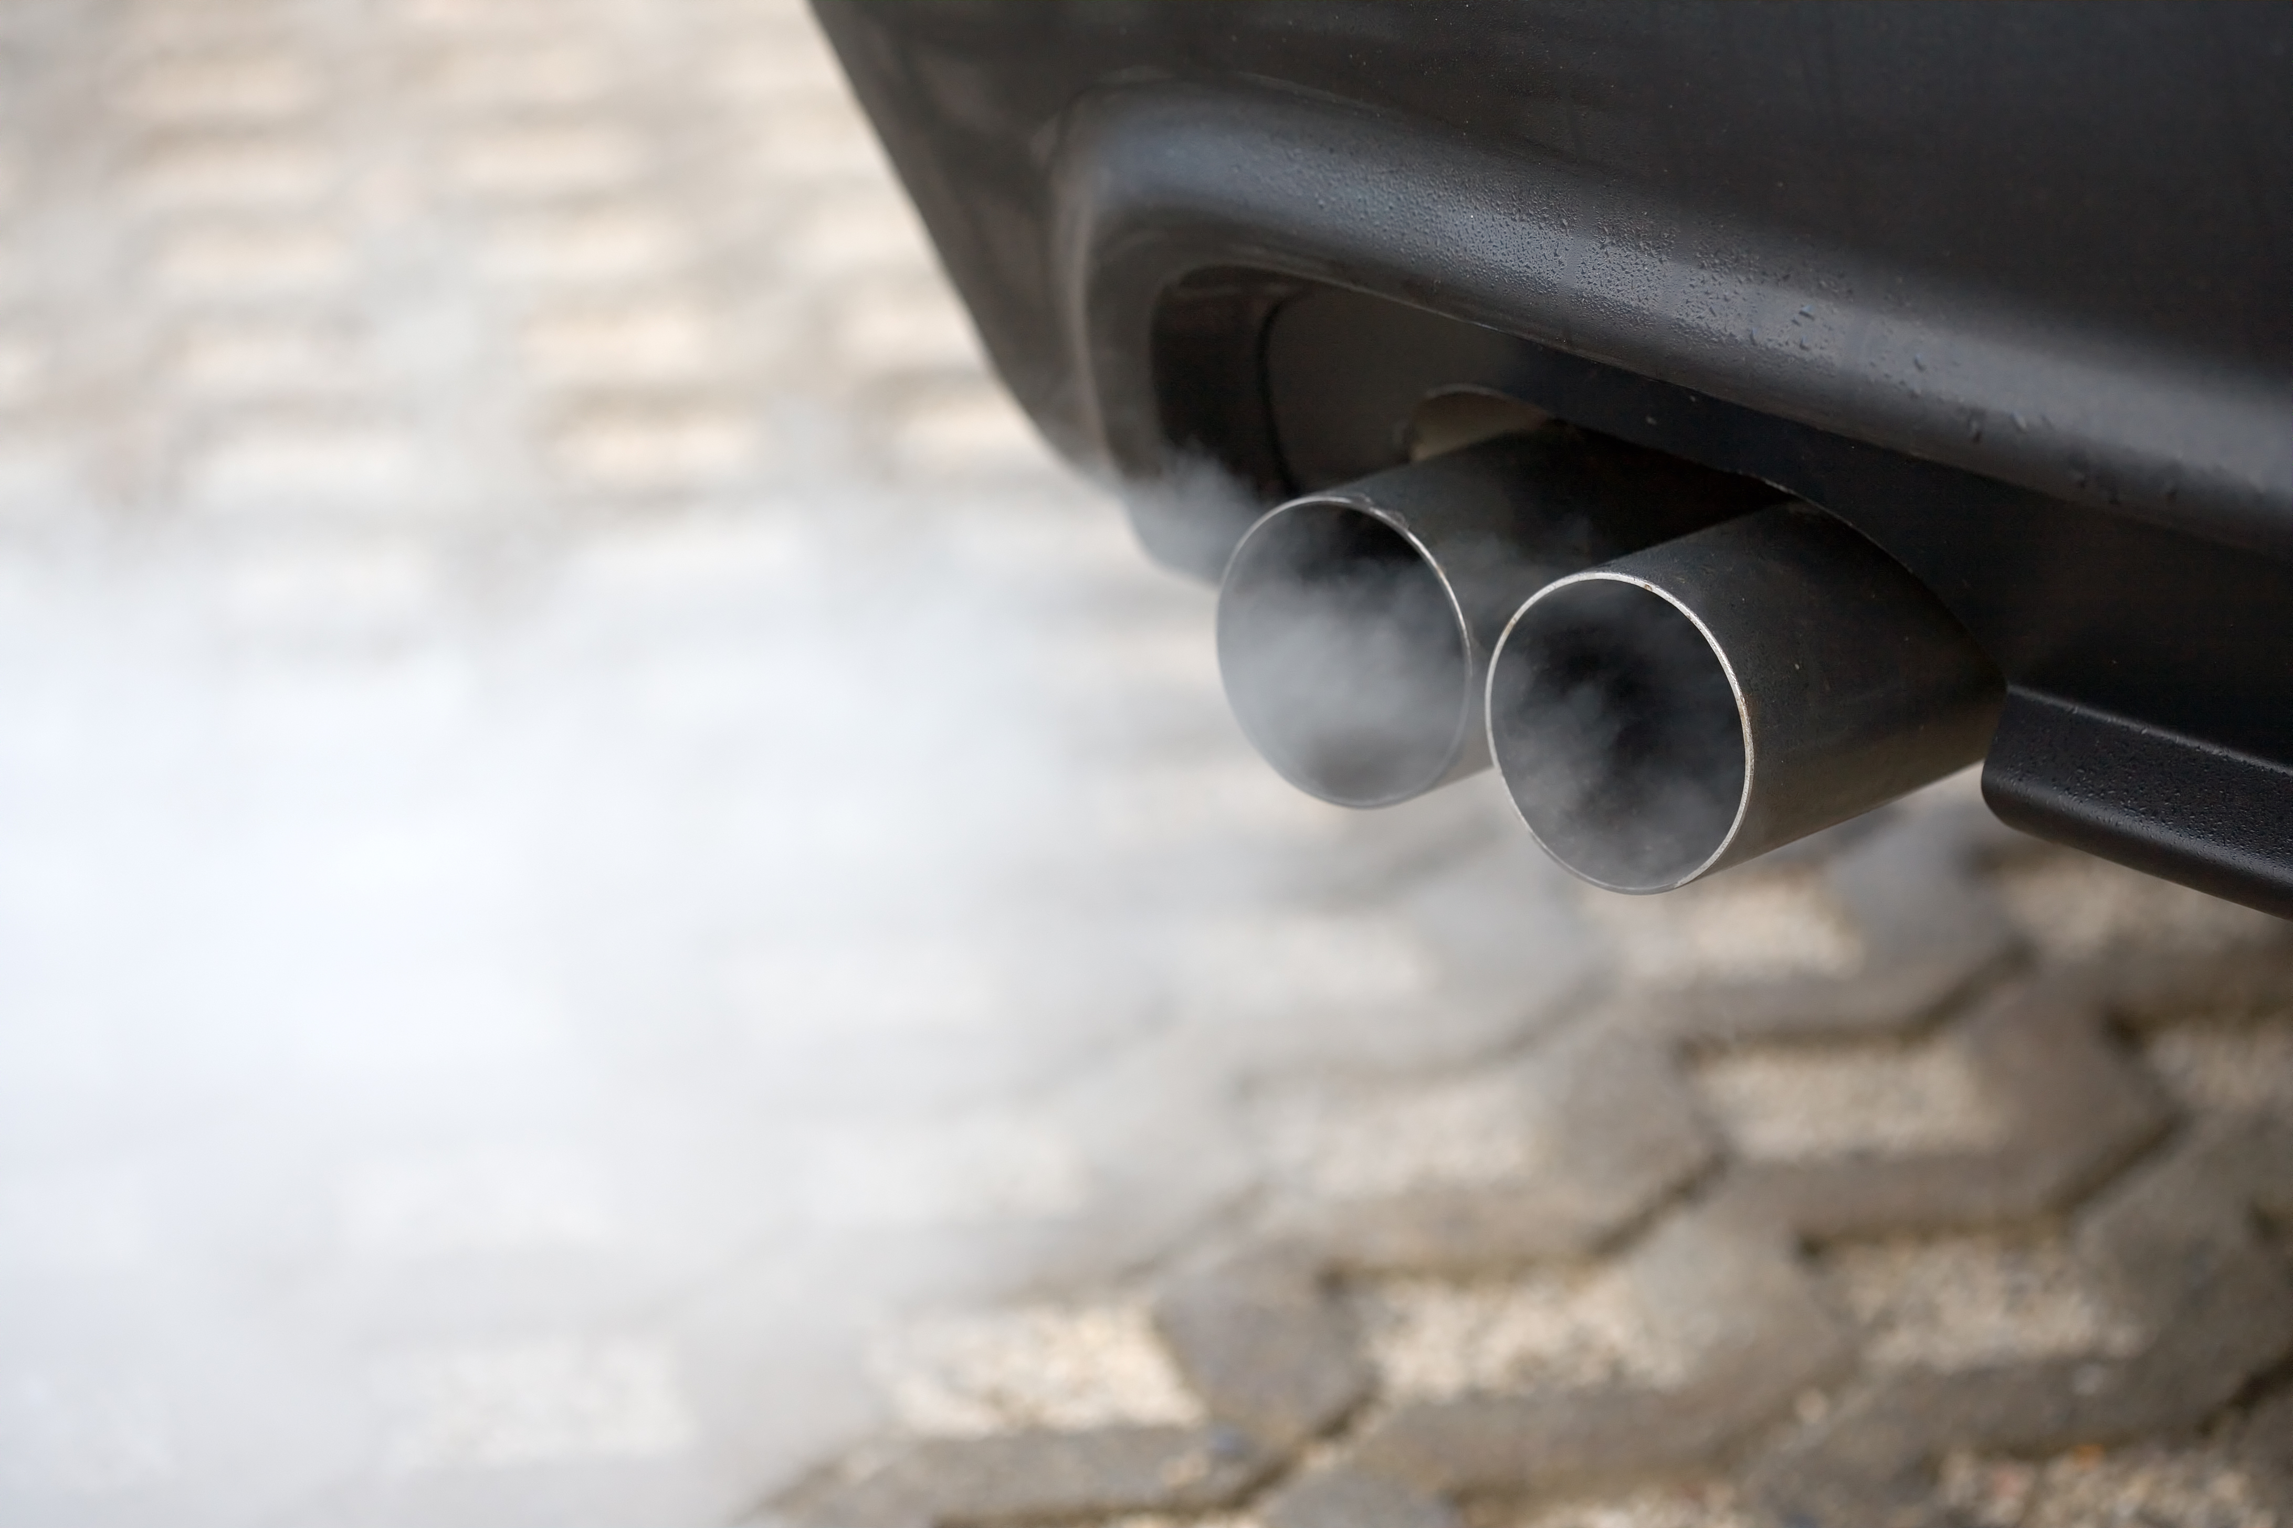
Carbon monoxide
Image from Gettyimages.com

Slide 10

A small molecule with a big impact
Hemoglobin in our blood prefers carbon monoxide (CO) to oxygen, so if given a choice, our blood will pick up carbon monoxide.
Unfortunately, we can’t use CO to breathe.
Image from Gettyimages.com
Notes:
Carbon monoxide is 300 times more attractive to hemoglobin than oxygen, so small amounts of carbon monoxide can tie up a lot of our blood’s ability to transport oxygen.

Slide 11

Symptoms of co poisoning
Confusion
Nausea
Headache
Dizziness
Tiredness
Death (severe poisoning)
Image from Gettyimages.com
Notes:
Low exposure to carbon monoxide can result in mild symptoms like headache, upset stomach, tiredness, or dizziness. High exposure leads to hypoxia (high-pox-ee-uh), which is extreme lack of oxygen. Hypoxia is dangerous since our muscles and organs need oxygen to survive, particularly the brain. If hypoxia continues for too long, permanent brain damage or death can occur.

Slide 12

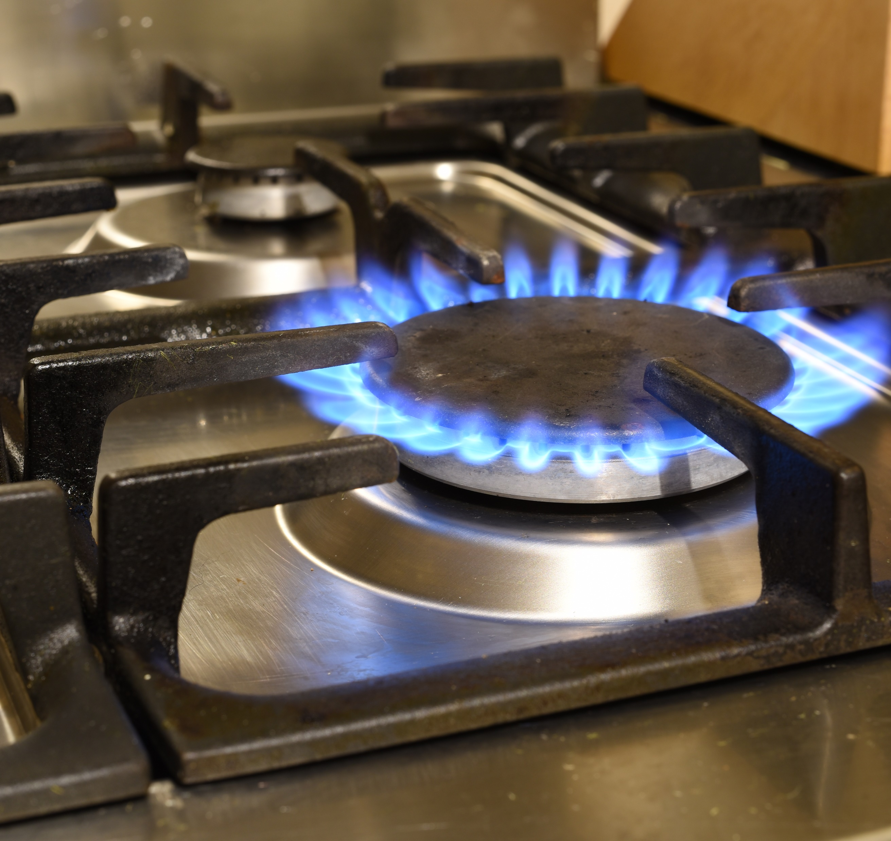
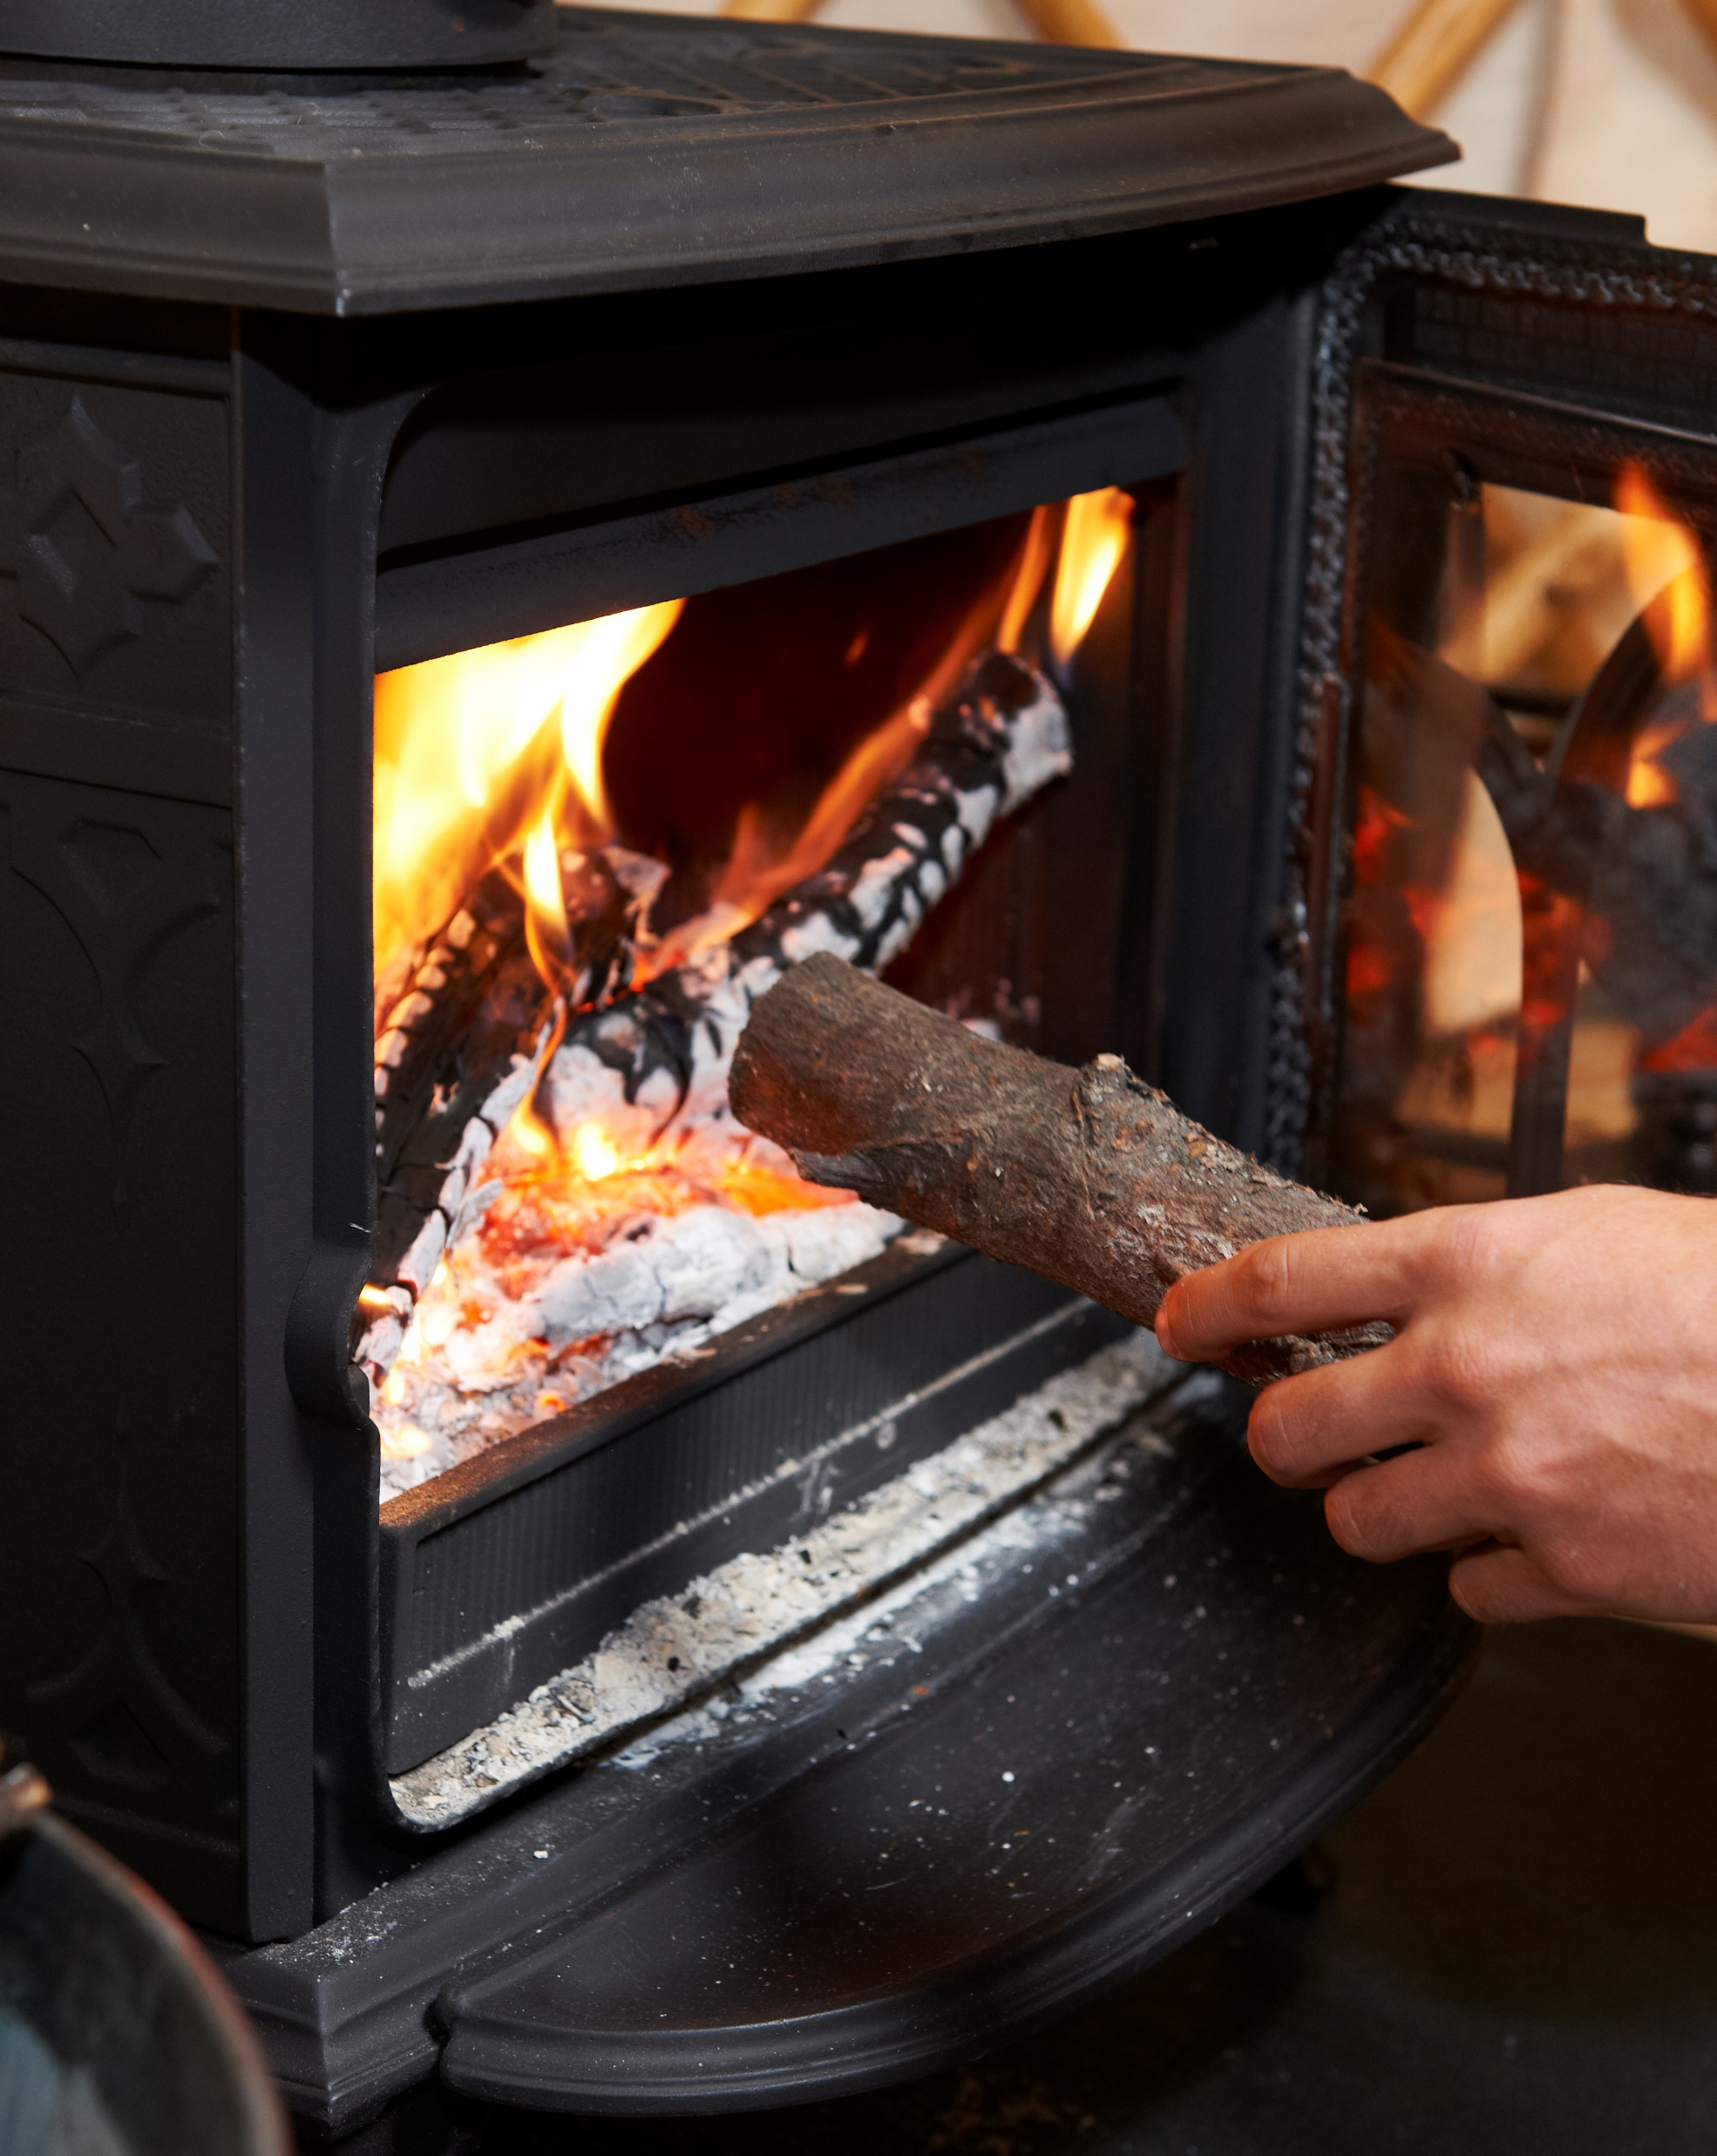
Sources of co
Liquid fuel?
Gas fuel?
Burns fuel?
Image from Gettyimages.com
Notes:
Most carbon monoxide is formed when fuel doesn’t burn all the way. Any time gasoline, kerosene, natural gas, or wood are burned, carbon monoxide is likely formed. The danger of carbon monoxide exposure increases in winter as more of us use combustion to heat our homes. When looking for possible sources of carbon monoxide, ask yourself:
does it use liquid fuel? (examples: kerosene heaters, cars warming up in a garage)
does it have a pilot light or is it hooked up to a gas line? (gas stove, gas water heater)
does it burn fuel to make warmth (fire in a fireplace)?

Slide 13
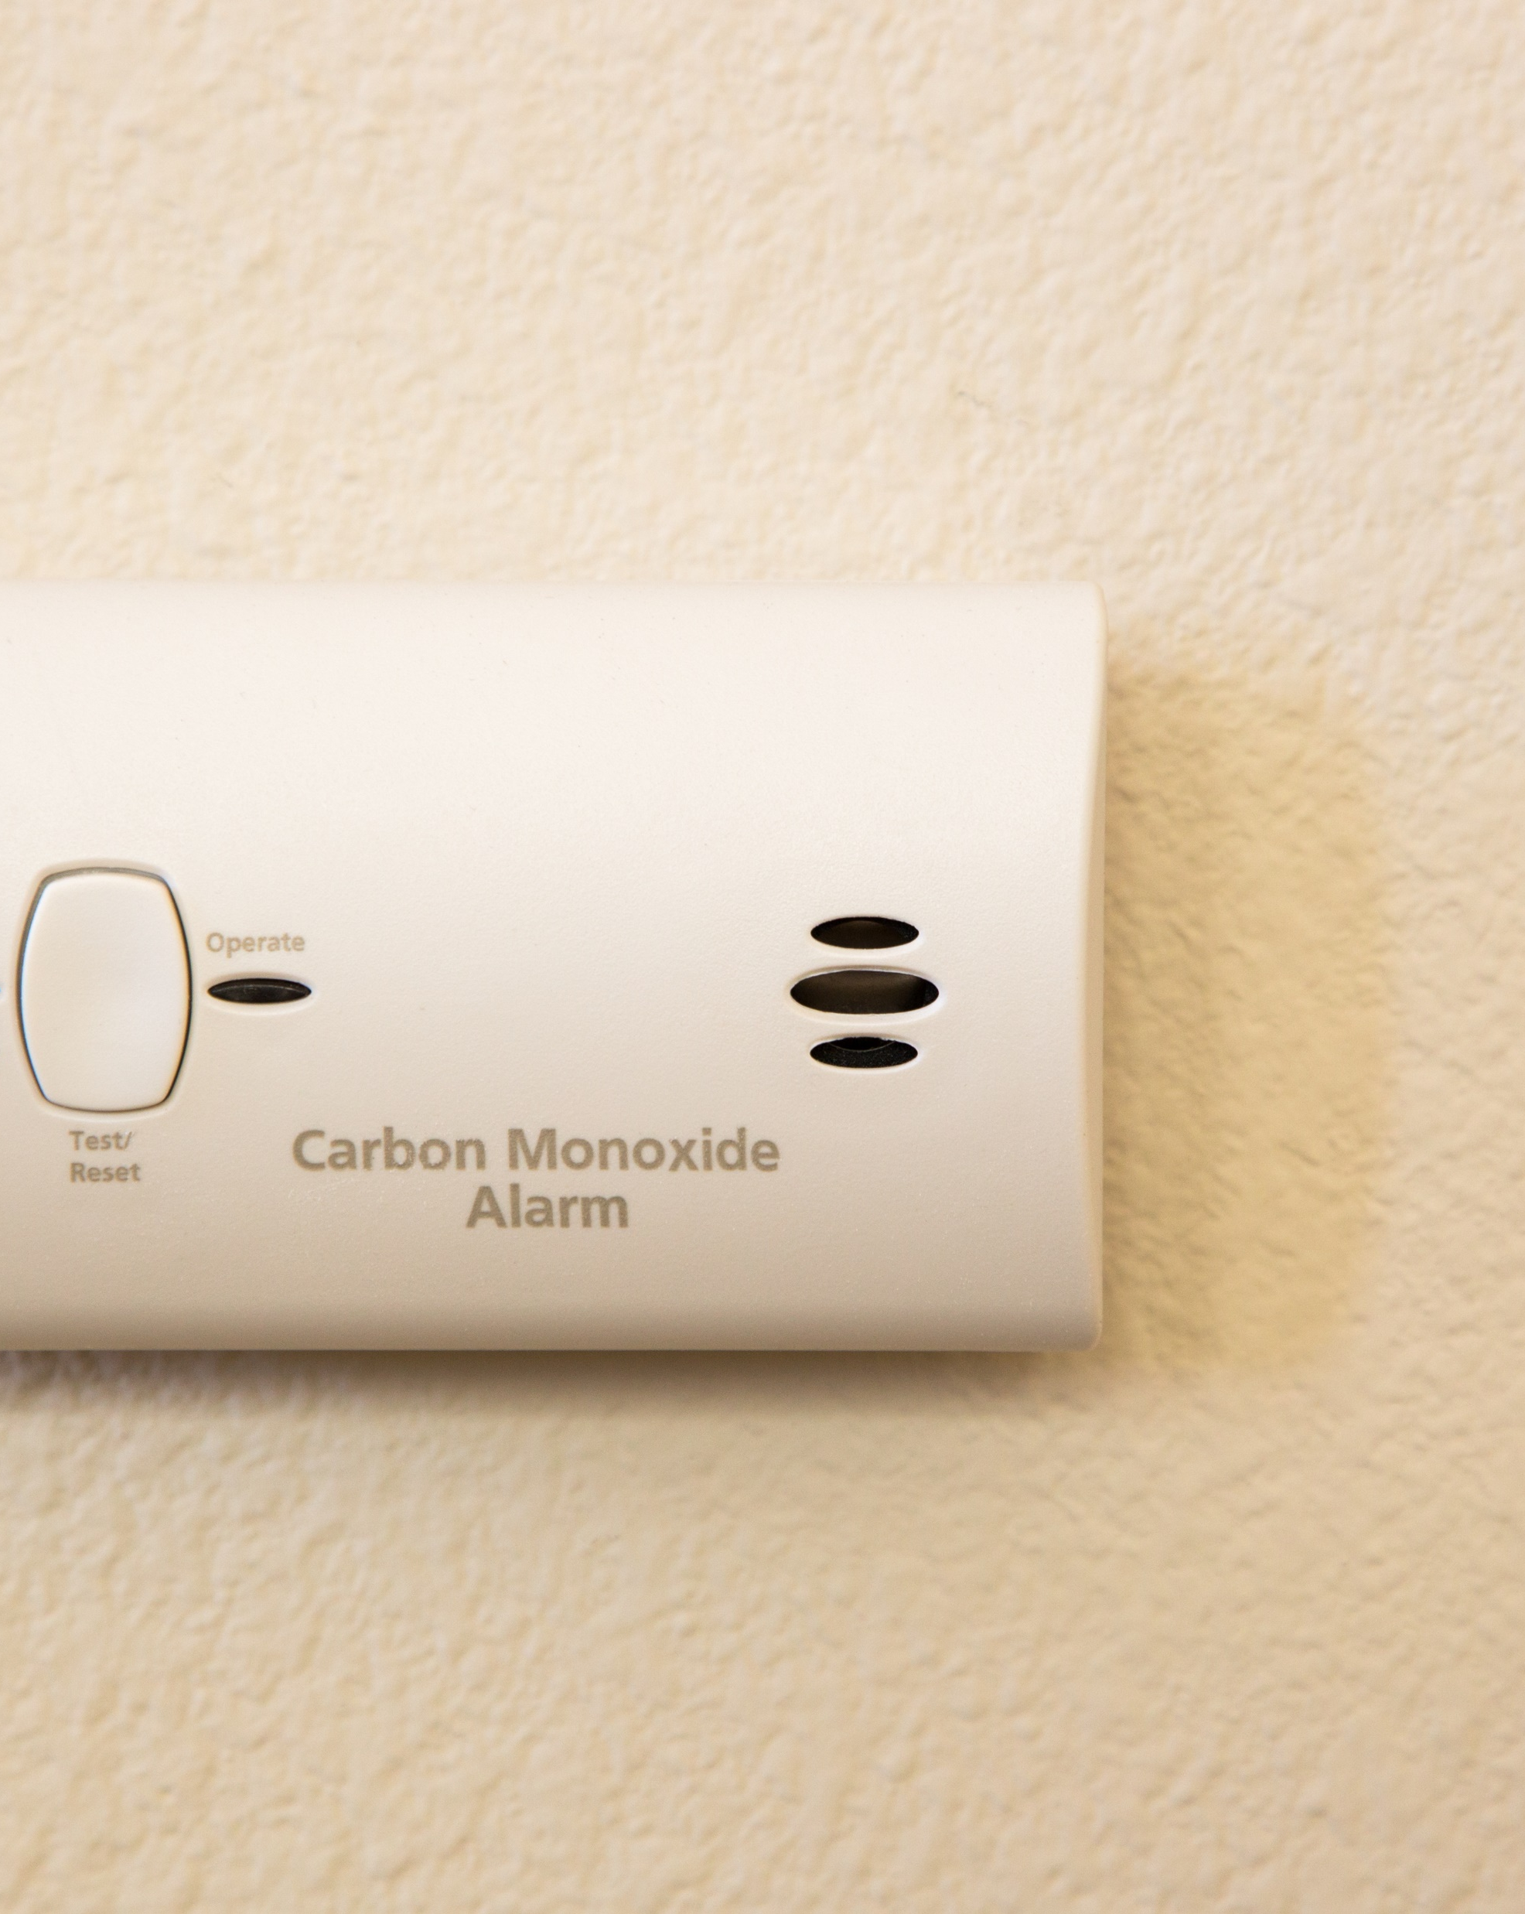

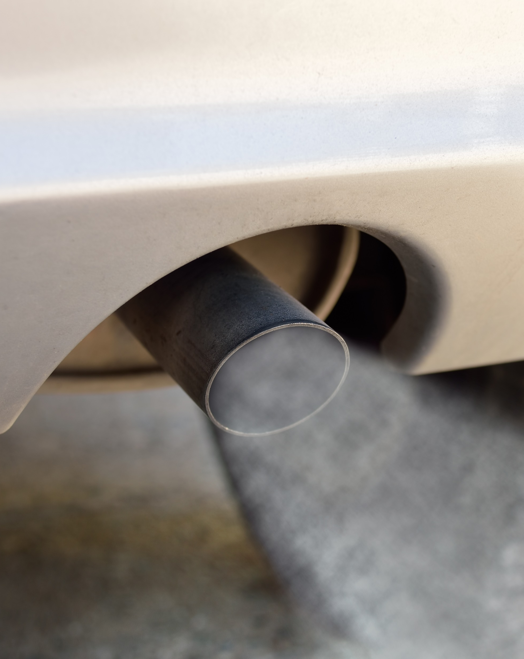
Ways to mitigate co exposure potential
Monitor
Maintain
Minimize enclosure
Image from Gettyimages.com
Notes:
Since we can’t smell carbon monoxide, we can’t rely on our nose to help us detect exposures. Instead, we can use a variety of techniques to minimize exposure.
If you have combustion in your home, invest in a carbon monoxide detector. Like a smoke detector, it is pre-set to go off in the presence of carbon monoxide instead of smoke.
Maintain equipment and chimneys. A dirty chimney may restrict air flow upward and encourage more smoke to enter the living space. Old hoses are more likely to leak. Dirty fittings may not allow for a consistent burn around a burner ring.
Minimize combustion heating in enclosed spaces. A car “warming up” in a closed garage is putting out carbon monoxide from the tailpipe. Over time the concentration of carbon monoxide builds.

Slide 14

Request a consultation
CO exposure can occur in the workplace anywhere fuel is burned.
We have trained staff who can help you evaluate your workers’ exposures to CO.
To request a consultation from our safety services staff, please use the QR code to the right.
Notes:
Our homes aren’t the only place where carbon monoxide exposure is a concern. At BWC Safety Services, we have staff trained in monitoring air contaminants, like carbon monoxide. Safety, industrial hygiene, and ergonomic consultations are available as part of your premium, so please reach out if you have a workplace safety concern.

