Slide 2
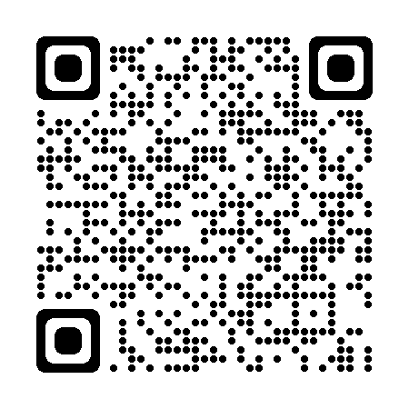
October Safety Council Update
Capital Area Safety Council
David
Vandergrift
bwc.ohio.gov
Safety Consultant
Office of Safety & Hygiene, Region 5
614-359-3554
David.V.1@bwc.ohio.gov
Notes:
Team prefers center text
QR Code takes you to BWC website.

Slide 3
Monthly Learning October 2024
October 1-2- OSHA 10: Construction safety basics – Columbus - Ohio Fire Academy
October 3- Emergency preparedness planning – Cincinnati /Springdale
October 7-10 - Electrical hazard recognition and abatement – Cincinnati/Springdale
October 9 - First aid in the workplace - Youngstown
October 10 - Lockout/tagout advanced principles - Canton
October 15 -16 - Respirator fit testing – Columbus- Delco
October 15 - First aid in the workplace - Portsmouth

Slide 4
Monthly Learning October 2024 ~ Continued
October 17 - Confined space: Identification and safe practice basics half-day workshop - Canton
October 28 - November 1 - OSHA 30: Construction safety principles – Columbus - Ohio Fire Academy
October 29 - Powered industrial trucks: Developing a training program half-day workshop - Cambridge
October 29 - 30 - OSHA10: Industry safety basics - Canton
October 30 - Noise and hearing conservation half-day workshop – Mansfield - Mid-Ohio Conference Center
October 31 - First aid in the workplace – Toledo - BGSU
Notes:
Make note to attendees sometimes classes get cancelled and not removed from the BWC web immediately, please check the BWCLearningCenter.com website to confirm all class schedules.

Slide 5
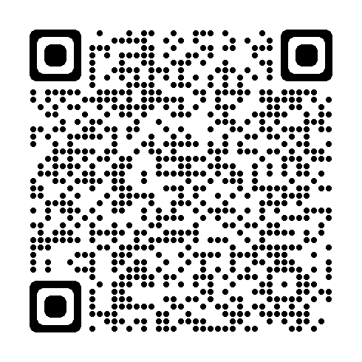
Monthly Learning November 2024
November 5 – First aid in the workplace – Cincinnati/Springdale
November 7 – Respirators: do we need them? – Cincinnati/Springdale
November 12 – First aid in the workplace – Canton
November 13 – Tree work essentials: Chainsaws, chippers and other safety concerns – Knox County - Mt Vernon
November 14 – Hazardous waste operations and emergency response refresher – Columbus – Ohio Fire Academy
November 19 – First aid in the workplace – Cleveland/Independence Indiana Wesleyan University
November 19-20 - OSHA 10: Construction safety basics – Toledo/Bowling Green State University
bwclearningcenter.com
IN-PERSON CLASSES and VIRTUAL TRAINING CLASSES (VTC) qualify for Safety Council rebate external training credits.
Notes:
Info found on BWC Learning Center is the most accurate. QR Code takes you to BWC Learning Center. Use log on credentials to see the training schedule.

Slide 6
virtual training October 2024
October 2 – Crisis de-escalation tactics and safe work practices workshop
October 8-9 – Health hazards and toxicology fundamentals
October 10 – Safety series workshop module 1: Introduction to OSHA requirements and safety culture basics
October 16-17 – Electrical safety in the workplace through insight and implementation of NFPA 70E
October 28-29 – Ergonomics and safety for extended-care facilities
October 30 – Bloodborne pathogens
IN-PERSON CLASSES and VIRTUAL TRAINING CLASSES (VTC) qualify for Safety Council rebate external training credits.

Slide 7
virtual training November 2024
November 5 – Job safety analysis
November 6 – Safety for the non-safety professional workshop
November 13-14 – Improving hazard recognition through visual literacy
November 14 – Developing a driver safety program
November 21 – Hazardous waste operations and emergency response awareness

Slide 8
Webinars October/November 2024
October 2 - What is risk management?
October 7 - Are you a confined spaces expert? Details you need to know.
October 8 - Employer update webinar
October 15 - Better You, Better Ohio! wellness webinar
October 24 - Employer update webinar
November 13 - Health-care facilities: Slips, trips, and falls.

Slide 9
Employer Deadline Dates
Private employer deadlines
Public employer deadlines
November 25 – PA Group Experience Rating application deadline for 7/1/2025
October 31 – PEC PY 2025 notice of estimated annual premium mailed November 15 – PEC deadline for deferred payment option for PY 2025 November 15 – PEC last date employer can change installment plan for PY2025 November 29 – DFSP application deadline for 1/1/2025 start date November 29 – PEC Transitional Work Bonus application deadline for 1/1/2025 start date.
Notes:
Refer attendees to their assigned Employer Service Specialist

Slide 10

ERGONOMICS: ENHANCING WORKER WELL-BEING
AND PRODUCTIVITY
Notes:
With October being National Ergonomics Month, now is the perfect time to explore the importance of ergonomics in your workplace.
Ergonomics is the science of designing workspaces to fit employees' needs and capabilities.
- Focuses on preventing discomfort and musculoskeletal disorders.
- Aims to improve employee well-being and productivity.
Importance of Ergonomics
- Reduces risk of injury and discomfort.
- Enhances productivity and job satisfaction.
- Supports overall health and well-being of employees.

Slide 11
INJURY CAUSATION
Notes:
In Ohio overexertion injuries account for 25% of all workers’ compensation claims. These sprain and strains injuries are often costly. The average lost time claim cost in 2022 for an overexertion injury is $18,000.
Benefits of Ergonomic Investments
- Reduced Discomfort and Fatigue: Leads to fewer absences, improved employee retention, and higher productivity.
- Cost Savings: Decreases the incidence of costly injuries and claims.
Simple changes can make a big difference, such as adjusting the height of a workstation, providing lift assist devices, and encouraging regular breaks.
2022 BWC Claim Data

Slide 12

BWC SAFETY SERVICES
This October prioritize ergonomics.
Ergonomics is a win-win.
Contact BWC Safety Services for expert assistance.
Notes:
For those looking to improve their ergonomic practices, BWC Safety Services is your partner. BWC provides comprehensive ergonomic services and guidance to help identify and address ergonomic risk factors in the workplace. These no-cost services include expert consultations, assessments, training, and resources designed to improve workplace safety and comfort. So, this National Ergonomics Month we encourage you to prioritize ergonomics in your workplace with the support of BWC Safety Services. Ergonomics is a win-win for both your employees and your business.
BWC Safety Services
- Provides no-cost ergonomic consultations and assessments.
- Offers training and resources to improve workplace safety and comfort.
How to Take Action
- Contact BWC Safety Services for expert guidance.
- Implement ergonomic practices to enhance workplace well-being and productivity.
National Ergonomics Month
- A great opportunity to prioritize and implement ergonomic improvements.
- Ergonomics is a win-win for both employees and your business.

